Slide 1
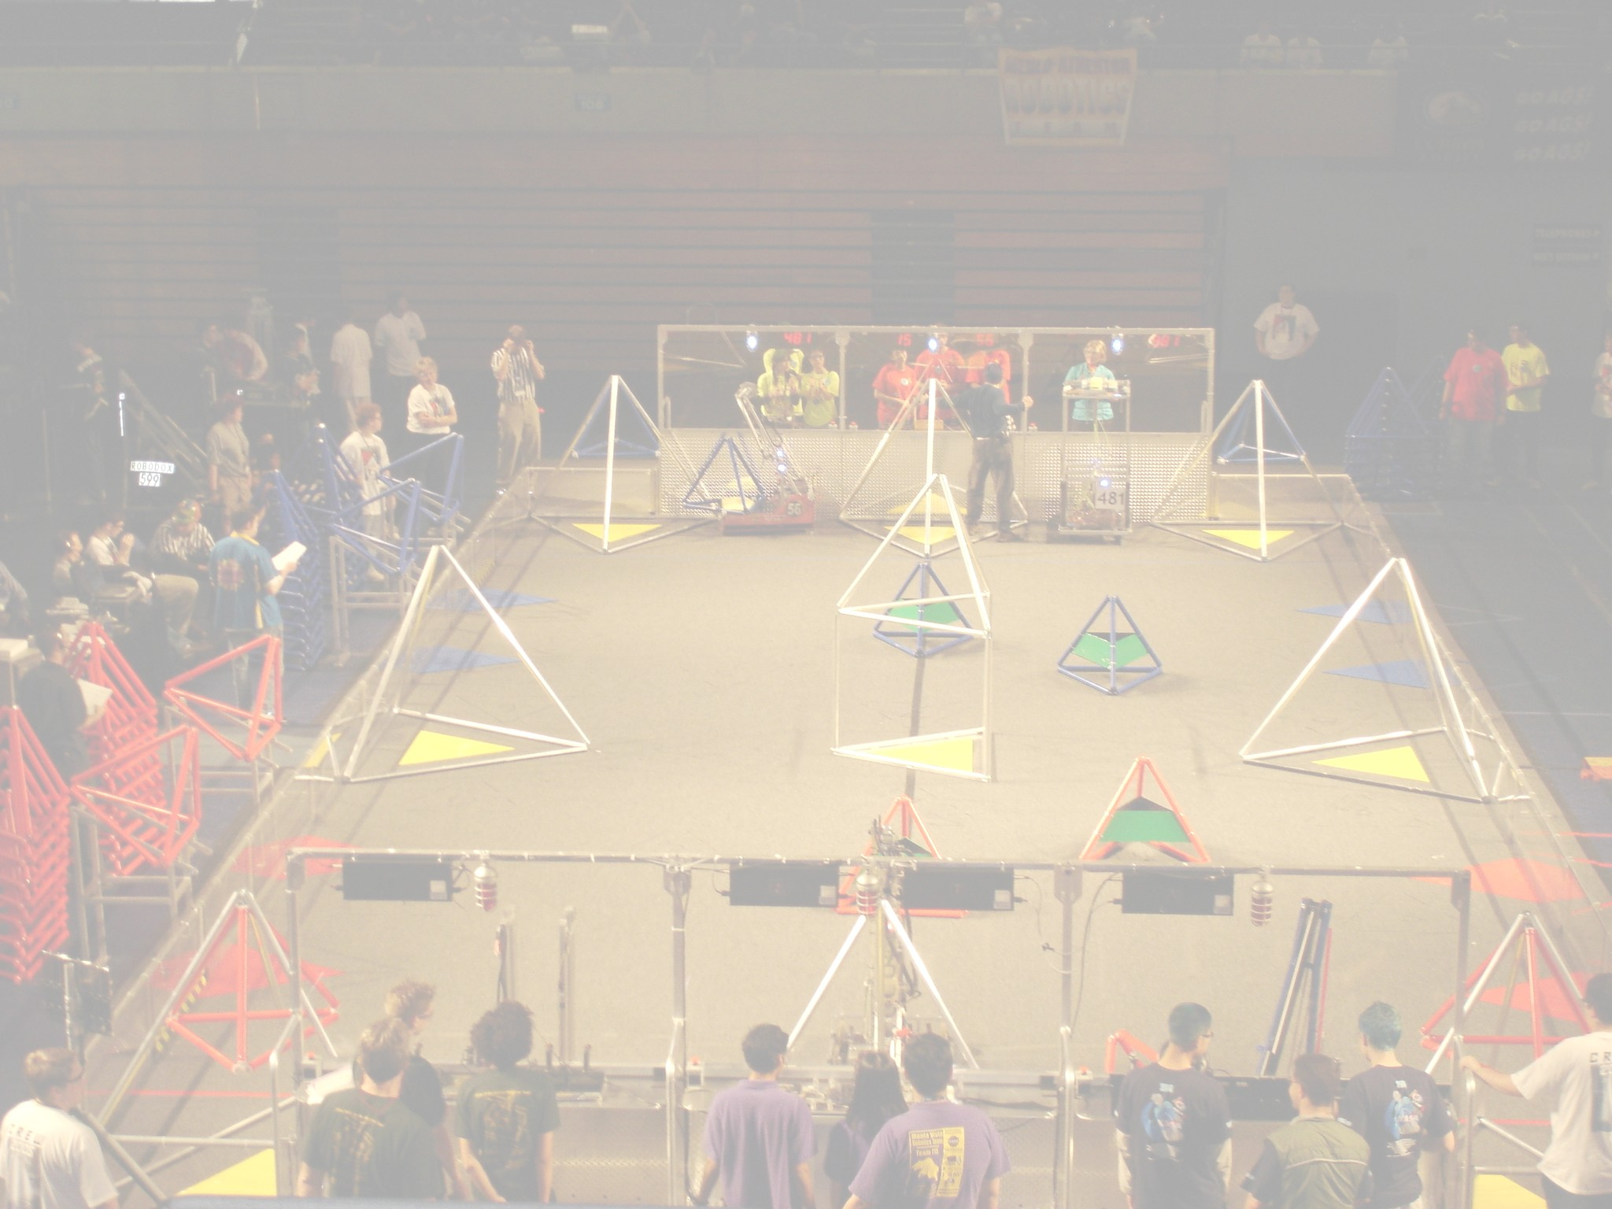
Pick Up Stix
A Pretend Robot Game

Slide 2
General Description
Robots will play 2 minute and 15 second matches with the first 15 seconds of the match in an autonomous mode. During the match the goal of the game is for robots to deposit their color of PVC “sticks” into their scoring area on the opposite side of the field.
2 points for each stick in a scoring trough
1 point for each stick touching a scoring zone
10 points for each stick placed onto one of the bonus racks
Scoring sticks during autonomous are doubled in value
10 point end game bonus for each robot that is atop of the platform in the middle of the field.
If an equal number of red and blue alliance robots are on the platform at the end of a match, each alliance receives coopertition points. 1 point for one red and one blue, 2 points for two red and two blue, 3 points for three red and three blue.

Slide 3
Field Layout
The field is standard size, 27’ x 54’, 3 robots per alliance.
There is a 8 foot wide, 8 foot long, 1 foot tall platform, covered with HDPE in the middle of the field.
Robots must start a match touching the trough nearest their alliance station.
At the beginning of each match 30 sticks of each alliance color will be lined up along the opposite alliance’s scoring trough. The sticks will be resting vertically against the trough, 10” apart from each other.
Each alliance station will also have 10 sticks of their color. These can be placed through a 1 ft x 1ft opening at the end of each alliance station wall.
Scoring troughs are comprised of a 30” wall placed 12” away from the alliance station wall for the length of the alliance station.
Three Bonus racks are formed at each end of the scoring troughs. Each rack section is 4” x 4” in size to accommodate 1 stick vertically.

Slide 4
Field Layout
Scoring Trough
30 Inch high wall
Red Alliance Station
8 ft
Blue Alliance Station
8.5 ft
15 ft
1 ft tall platform
15 ft
8.5 ft
Bonus Racks

Slide 5
Rules
The first 15 seconds of the match, the robots must autonomously operate.
Robots can start with 1 stick in their robot’s possession.
Robots must start the match no larger than 28” x 38” x 60”
Sticks are made from 2.5” PVC segments, 36” long, capped at each end.
Robot kits and legal parts are similar to last year
Sticks that are in contact with a robot (a red alliance robot touching a red stick) at the end of a match or auto mode do not count.
Sticks must be touching the floor of the scoring zone to count. Sticks must be within the volume of a scoring trough to count as in the trough. Sticks must be in the volume of the bonus rack to count as in the rack.
Sticks that leave the field will be placed back into play in a random location.

Slide 6
Design Task
With your group, design a strategy of play and a preliminary robot design for this game.
You will present your approach to the class on the day of Finals. Use aids, 3D models, pictures, sketches to help pitch your design.
Everyone will individually vote on the best strategy / design. The winner will receive 10 bonus points.
The project is to be done in a group and is worth 50 pts towards your final exam grade. Work together and find ways in which everyone contributes to the task.

